Slide 1
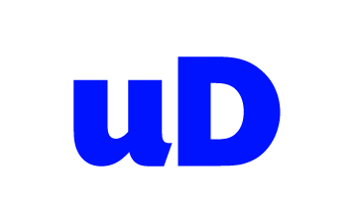
Introduction to Docker Workshop
Pini Reznik & Mark Coleman
www.uglyduckling.nl
Notes:
Opening question: how many developers? Sys-admins? DevOps? Other?

Slide 2
Agenda
Install Docker
Introduction to Containers and Docker
Workshop
Future of Infrastructure
Antitude

Slide 3
Docker installation

Slide 4
Docker Installation
Mac
https://docs.docker.com/installation/mac/
Windows https://docs.docker.com/installation/windows/
Other https://docs.docker.com/installation/#installation

Slide 5
Introduction to Docker

Slide 6
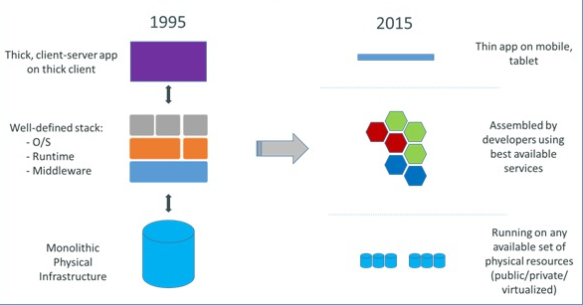
Evolution of IT
Notes:
I would like to start with a bit of history
1995: Single HW server -> Well-Defined Middleware and OS -> Thick SW
2015: Variety of HW, clouds -> Middleware based on dozens/hundreds of 3rd party components -> Thin application
Since 90s we learned how to reuse existing technologies and by that increase the speed of development of new features.
But increase of reliance on growing number of components made the deployment process pain in the ass.

Slide 7
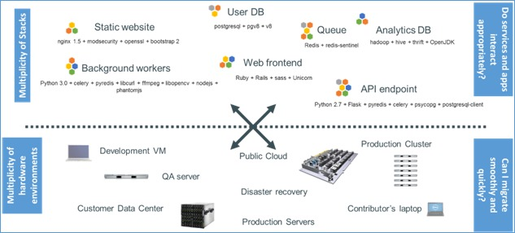
Challenge of Multiple Environments
Notes:
UP: Web servers, Load Balancers, DBs, queues, monitoring, …
Down: VMs, cloud, Laptops, Dev/Test/Acceptance/Production
Complexity in such environment is growing day by day. All this various SW components should fit the middleware and run on different types of HW

Slide 8
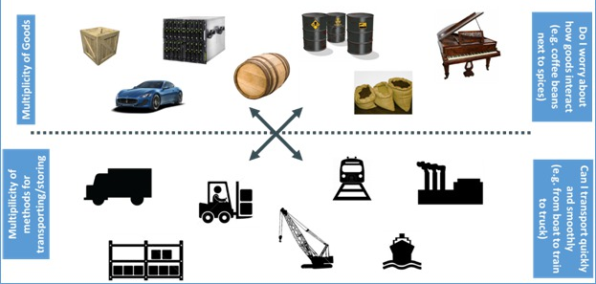
Cargo Analogy
Notes:
At this point I would like to suggest cargo shipment analogy.
The situation in the goods delivery logistics just about 60 years ago was very similar to our software delivery situation right now.
Variety of transportation and storage means and complexity of fitting different types of goods in.

Slide 9
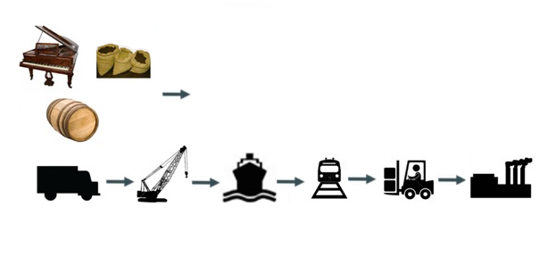
Cargo Delivery Pipeline
Notes:
Goods being shipped through delivery pipeline.
Different formats, packaging. Interaction between goods. Each stage in the pipeline needs to support all possible formats. Including yet to be invented

Slide 10
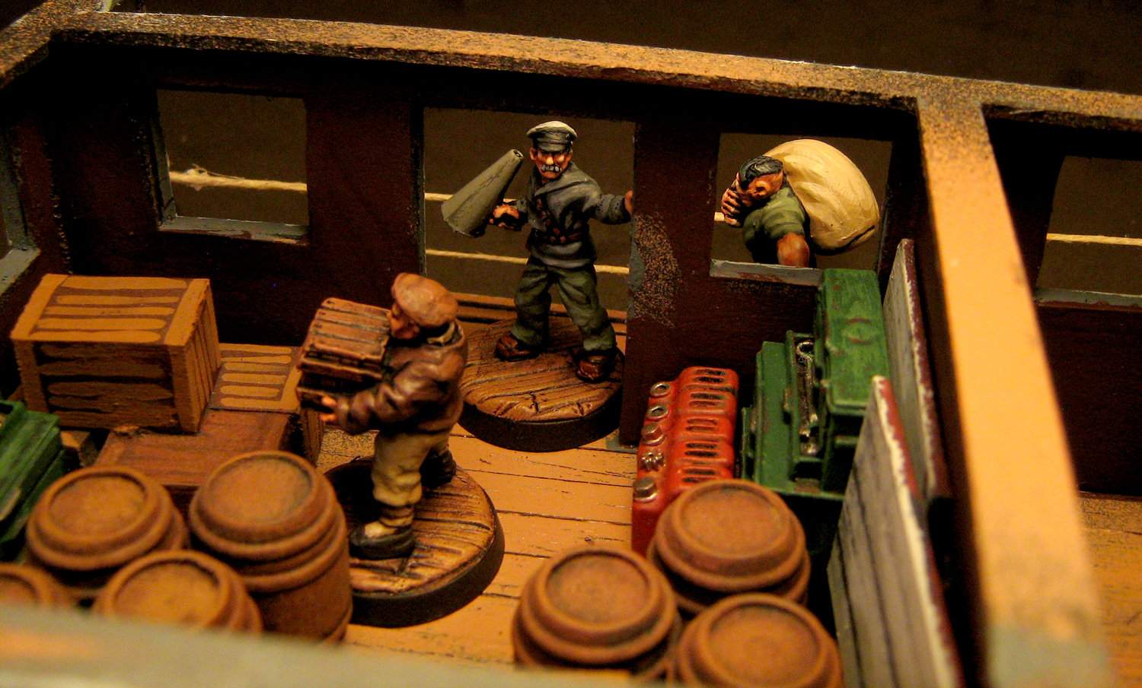
Shipping Goods
Notes:
And that is how the work is typically done at such pipeline.
It is manual, complicated and requires understanding of the content by the workers.
Does it remind you anything? ☺
Think what would say an operational person in the picture to two teams of developers who built round barrels and square boxes. ☺
Ad what will say at the destination then coffee will smell like spices.

Slide 11
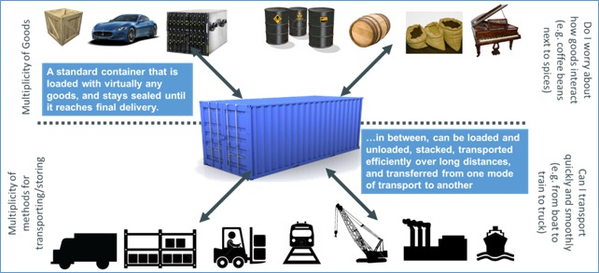
Shipping with Containers
Notes:
The solution is – standardized containers.
All types of storage and transportation support containers.
They are always sealed and the content is separated from the content of other containers.
Now developers can build anything they want as long as it fits into container and operations can focus of maintenance of the infrastructure.
Maybe they can finally fix those railroads. ☺ and finish the metro line

Slide 12
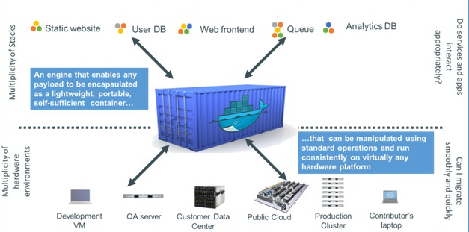
Software in Containers
Notes:
The solution will be very similar.
Developers will build their stuff and place it in a standard container. Such container will be picked up by an operations and deployed to variety of different platforms without concern of dependencies and incompatibilities.
This is not 100% accurate but it is definitely much better than the current situation

Slide 13
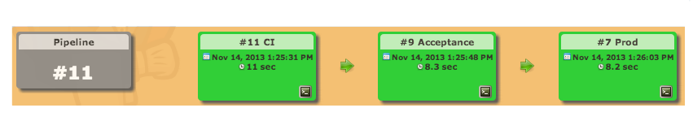
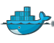
Delivery Pipeline with Containers
Development
Environment
Setup
Test
Clean
Environments
Acceptance
Similarity to
Production
Production
Deployments and
Roll-back/forwards
Notes:
The solution for many problems you suggested earlier can be Docker, which will be used to run your software quickly and consistently at all stages of the delivery pipeline
Containers are easily built and can be started in fraction of a second.
They provide similar protection from the external environment as shipping containers provide to the delivered goods.

Slide 14
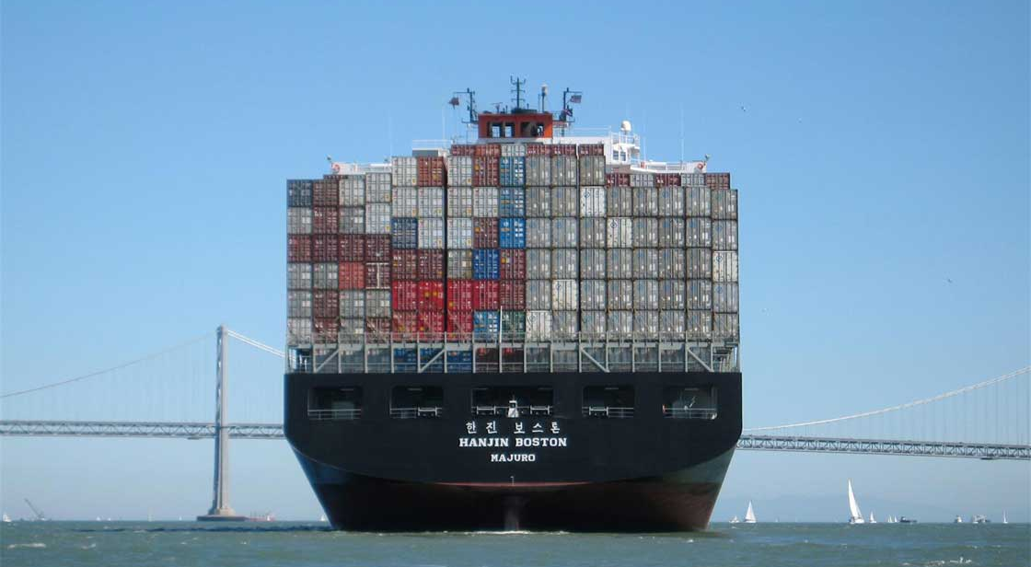
Scalability with Containers
Notes:
And that is how scalability is done in the world of containers. ☺
How would you put a piano on such ship without a container? ☺

Slide 15
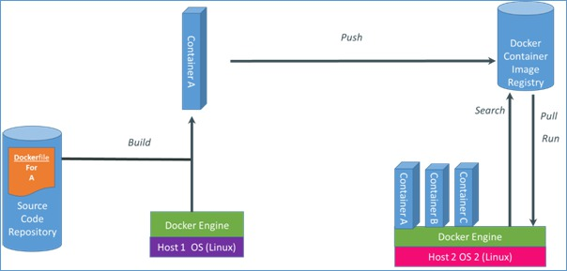
Docker Functions
Notes:
In a very simplistic way we can say following about docker functionality.
It is based on existing technologies LXC containers, cgroups and AUFS
There are
dockerfiles which are similar to source code and used to build the images.
Build process. Inherits an image, creates container, runs commands from Dockerfile inside and creates a new image.
New image is pushed into central repo - Docker Index. Central or Local
When container is started it will pull the relevant image, cache it locally and create container out of it. First time includes downloading, secont time is typically around 0.100 Sec
Container will run on basically any Linux with Kernel 3.8+ or in any VM with such Linux. As well as natively on some cloud systems like OpenStack and at some service providers like dotCloud and DigitalOcean

Slide 16
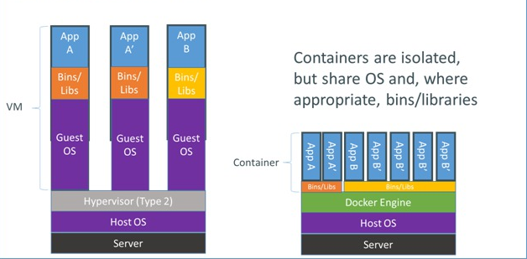
Docker and VMs
Notes:
Basically VM can do everything Docker does and more except:
It is less portable. Most of the hypervisor and clouds have different VM formats despite the attempts to standardize them.
More resources required to run VMs.
Building VM will take anywhere between 5-30 minutes
Startup time is is typically around few minutes.
This makes creation on new VMs difficult and cumbersome which in turn will create the situation where developers try to avoid recreation of VMs as much as possible

Slide 17
Supported Platforms
Host
Any Linux with kernel >3.8.x
Container
Same architecture as the host
Notes:
Basically VM can do everything Docker does and more except:
It is less portable. Most of the hypervisor and clouds have different VM formats despite the attempts to standardize them.
More resources required to run VMs.
Building VM will take anywhere between 5-30 minutes
Startup time is is typically around few minutes.
This makes creation on new VMs difficult and cumbersome which in turn will create the situation where developers try to avoid recreation of VMs as much as possible

Slide 18




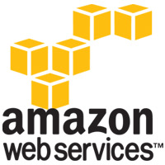

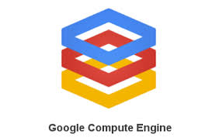
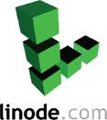




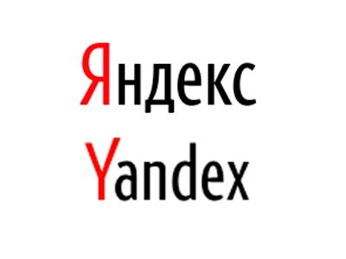
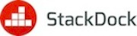
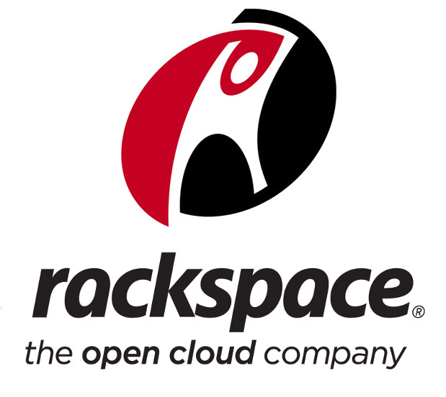
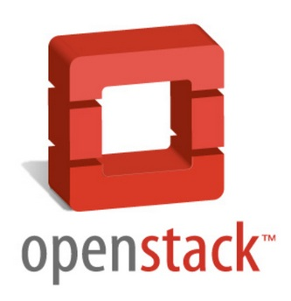



Docker Integrations and Hosting
NL

Slide 19
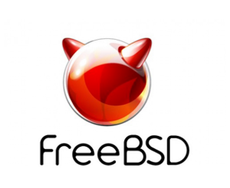

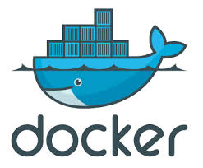
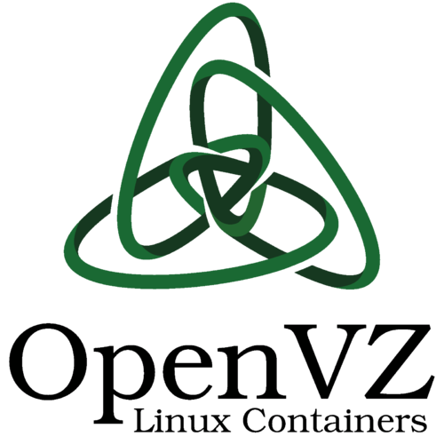
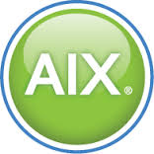

OS Level Virtualization
ZONES
JAILS
Workload
Partitions
Notes:
Basically VM can do everything Docker does and more except:
It is less portable. Most of the hypervisor and clouds have different VM formats despite the attempts to standardize them.
More resources required to run VMs.
Building VM will take anywhere between 5-30 minutes
Startup time is is typically around few minutes.
This makes creation on new VMs difficult and cumbersome which in turn will create the situation where developers try to avoid recreation of VMs as much as possible

Slide 20
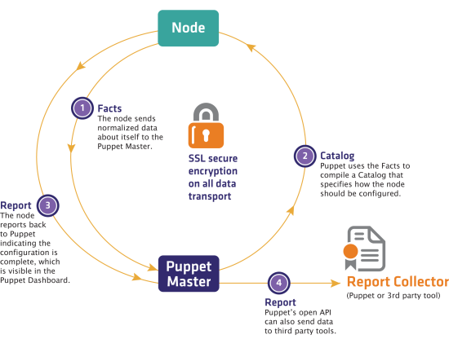
Docker and Puppet/Chef/Ansible
Notes:
Puppet and chef is like building a robot to move those barrels, boxes and pianos around.
It is better than doing it manually the complexity makes it too expensive for simple situation.
In typical environment VMs and puppet/chef/ansible will be used in conjunction.
Both are very useful and Docker is not going to replace them, it will be added to the mix. Puppet/chef are good to manage underling infrastructure and VMs are very important for building clouds.

Slide 21
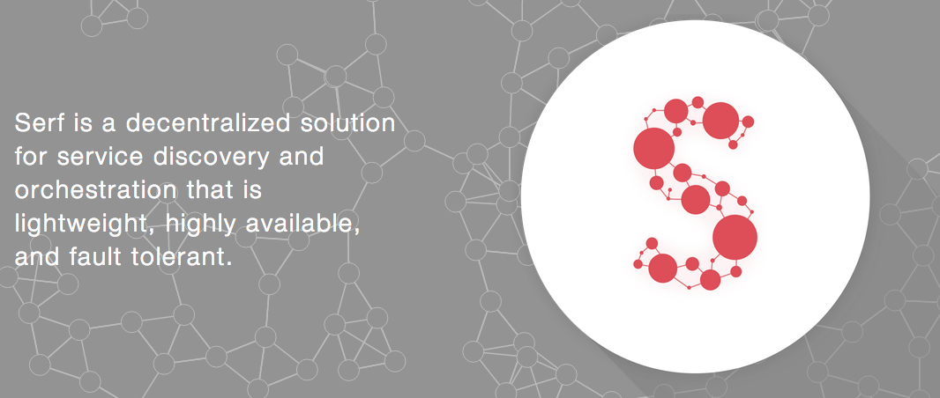
Communication - Serf

Slide 22
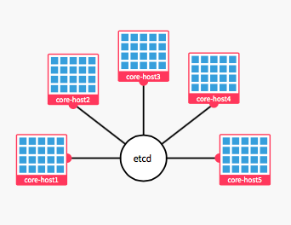
Infrastructure - CoreOS

Slide 23
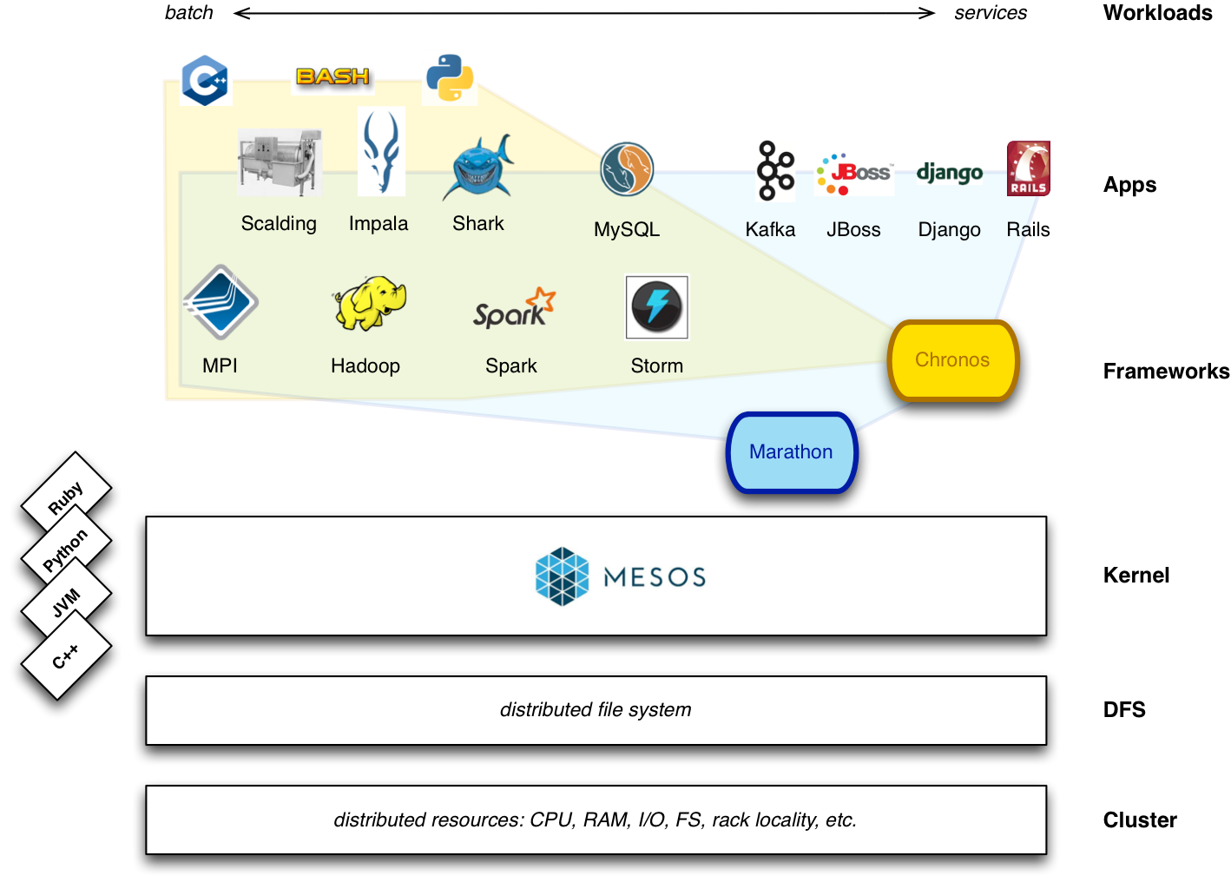
Cluster Management - Mesos

Slide 24
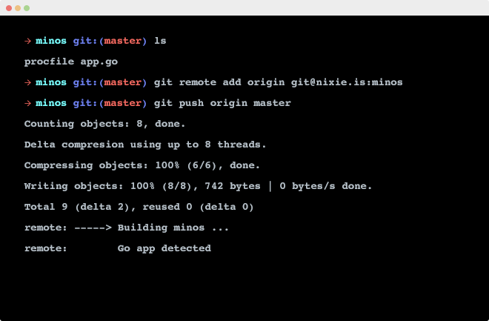
PaaS, Heroku style - Flynn

Slide 25
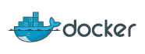
Software Configuration Management Done Right.
Everything (almost) we need to build our
Software is now finally in the Version Control

Slide 26
workshop

Slide 27
boot2docker
$ boot2docker init
$ boot2docker start
$ boot2docker ssh
OR
$ boot2docker init
$ boot2docker start
$ export DOCKER_HOST=tcp://$(boot2docker ip 2>/dev/null):2375

Slide 28
Docker run
$ docker run ubuntu ls
$ docker run -i -t –name file -v `pwd`:/tmp/on_host -w `pwd` ubuntu bash
touch /tmp/file_a.txt
touch /tmp/on_host/file_b.txt
exit
$ docker diff file

Slide 29
Docker attach/stop/start
$ docker run -d -name while ubuntu /bin/sh -c "while true; do echo hi; sleep 1; done"
$ docker attach while
$ docker stop while
$ docker start while

Slide 30
Docker log/inspect/ps/top
$ docker ps
$ docker ps –a
$ docker top while
$ docker logs
$ docker inspect

Slide 31
Docker kill/rm/rmi
$ docker kill
$ docker rm
$ docker rmi

Slide 32
Dockerfile
FROM ubuntu
MAINTAINER UglyDuckling "info@uglyduckling.nl"
RUN echo deb http://archive.ubuntu.com/ubuntu precise universe >> /etc/apt/sources.list
RUN apt-get update
RUN apt-get install -q -y vim
ENV ENV_VAR some_stuff
ADD file.txt /file.txt
EXPOSE 8080
CMD ["bash", "-c", "ls", "/"]

Slide 33
Docker build/tag
$ docker build -t you_name/sample .
$ docker run you_name/sample
$ docker run -i -t you_name/sample bash
ls /file.txt
exit

Slide 34
Docker commit/pull/push (skipping)
https://registry.hub.docker.com/

Slide 35
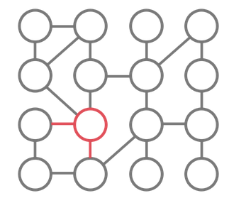
Serf
Gossip-based membership
Failure detection
Custom events

Slide 36
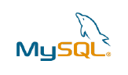


Wordpress/MySQL Exercise
Connected
Serf agents
DOCKER
Containers
HOST
Based on www.centurylinklabs.com/decentralizing-docker-how-to-use-serf-with-docker/

Slide 37
Checkout and build all containers
$ git clone https://github.com/pinireznik/DockerWorkshop.git
$ cat ./build.sh
$ ./build.sh

Slide 38
Start Serf container
$ SERF_ID=$(docker run -d --name serf_1 -p 7946 -p 7373
ud/serf /run.sh)

Slide 39
Install and start Serf on Host
# Install Serf
$ wget dl.bintray.com/mitchellh/serf/0.5.0_linux_amd64.zip
$ unzip 0.5.0_linux_amd64.zip
$ sudo mv serf /usr/bin/
# Start local agent and connect to the first Serf agent
$ serf agent &
$ serf join $(docker port $SERF_ID 7946)

Slide 40
Start MySQL container
$ MYSQL_ID=$(docker run -d --name mysql --link serf_1:serf_1 -p 3306 ud/mysql-serf /run.sh)
$ docker logs $MYSQL_ID
# locate the password in docker logs and set env. variable.
$ DB_PASSWORD=v6Dax72kQzQR

Slide 41
Create database
# create temporary container with MySQL client to create DB
$ docker run -t -i --name mysql_client --link mysql:mysql -p 3306 ud/mysql-serf bash
# create DB from inside container
mysql -uadmin -p$DB_PASSWORD -h
$MYSQL_PORT_3306_TCP_ADDR -P 3306 -e "create database wordpress;"

Slide 42
Start Wordpress
$ WORDPRESS_ID=$(docker run -d --name wordpress --link
serf_1:serf_1 -e="DB_PASSWORD=$DB_PASSWORD" -p 80 ud/wordpress-serf /run.sh)

Slide 43
Test
# connect to the Workdpress site
$ curl --location http://$(docker port $WORDPRESS_ID 80)/
$ curl --location http://$(docker port $WORDPRESS_ID 80)/
readme.html
# kill DB and see what happens
$ docker kill mysql
$ curl --location http://$(docker port $WORDPRESS_ID 80)/

Slide 44
Demo
Android Development Env. in Docker container
Jenkins in a container
Parallel testing using multiple containers
Django in a container
Java development in a container

Slide 45
Future of infrastructure

Slide 46
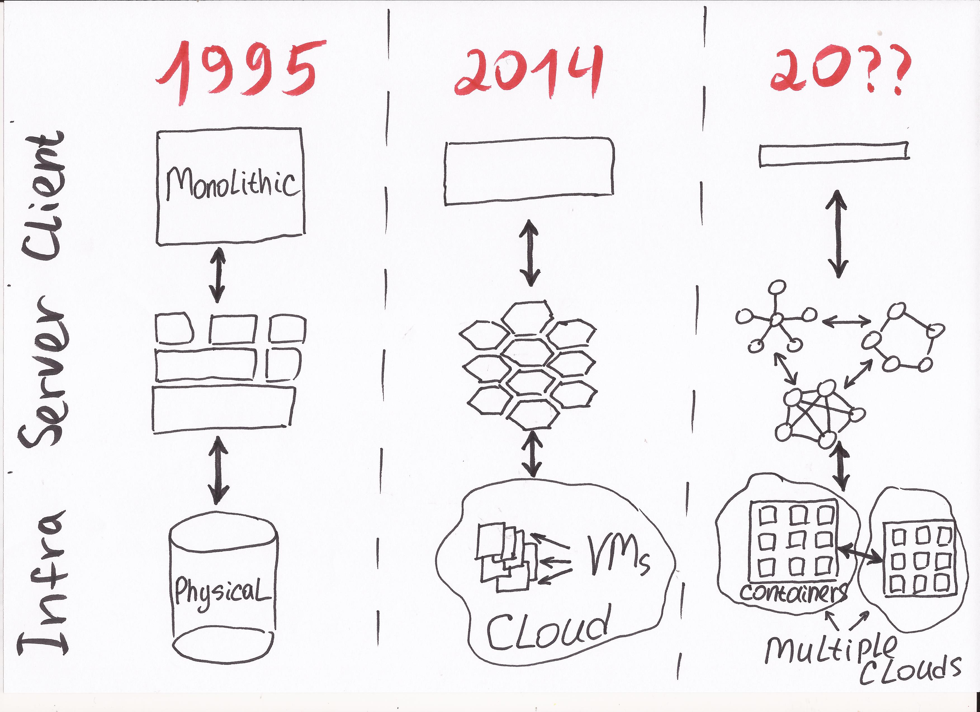
Evolution of IT the Next Step
Notes:
If we look at IT systems at the last two decades we can see that these systems are moving from a monolithic architecture running on physical hardware to clusters of smaller services that are often served in a cloud. During the last 10 years we saw the physical hardware abstracted away to allow creation of clouds.
the question is what will we see in the future?

Slide 47
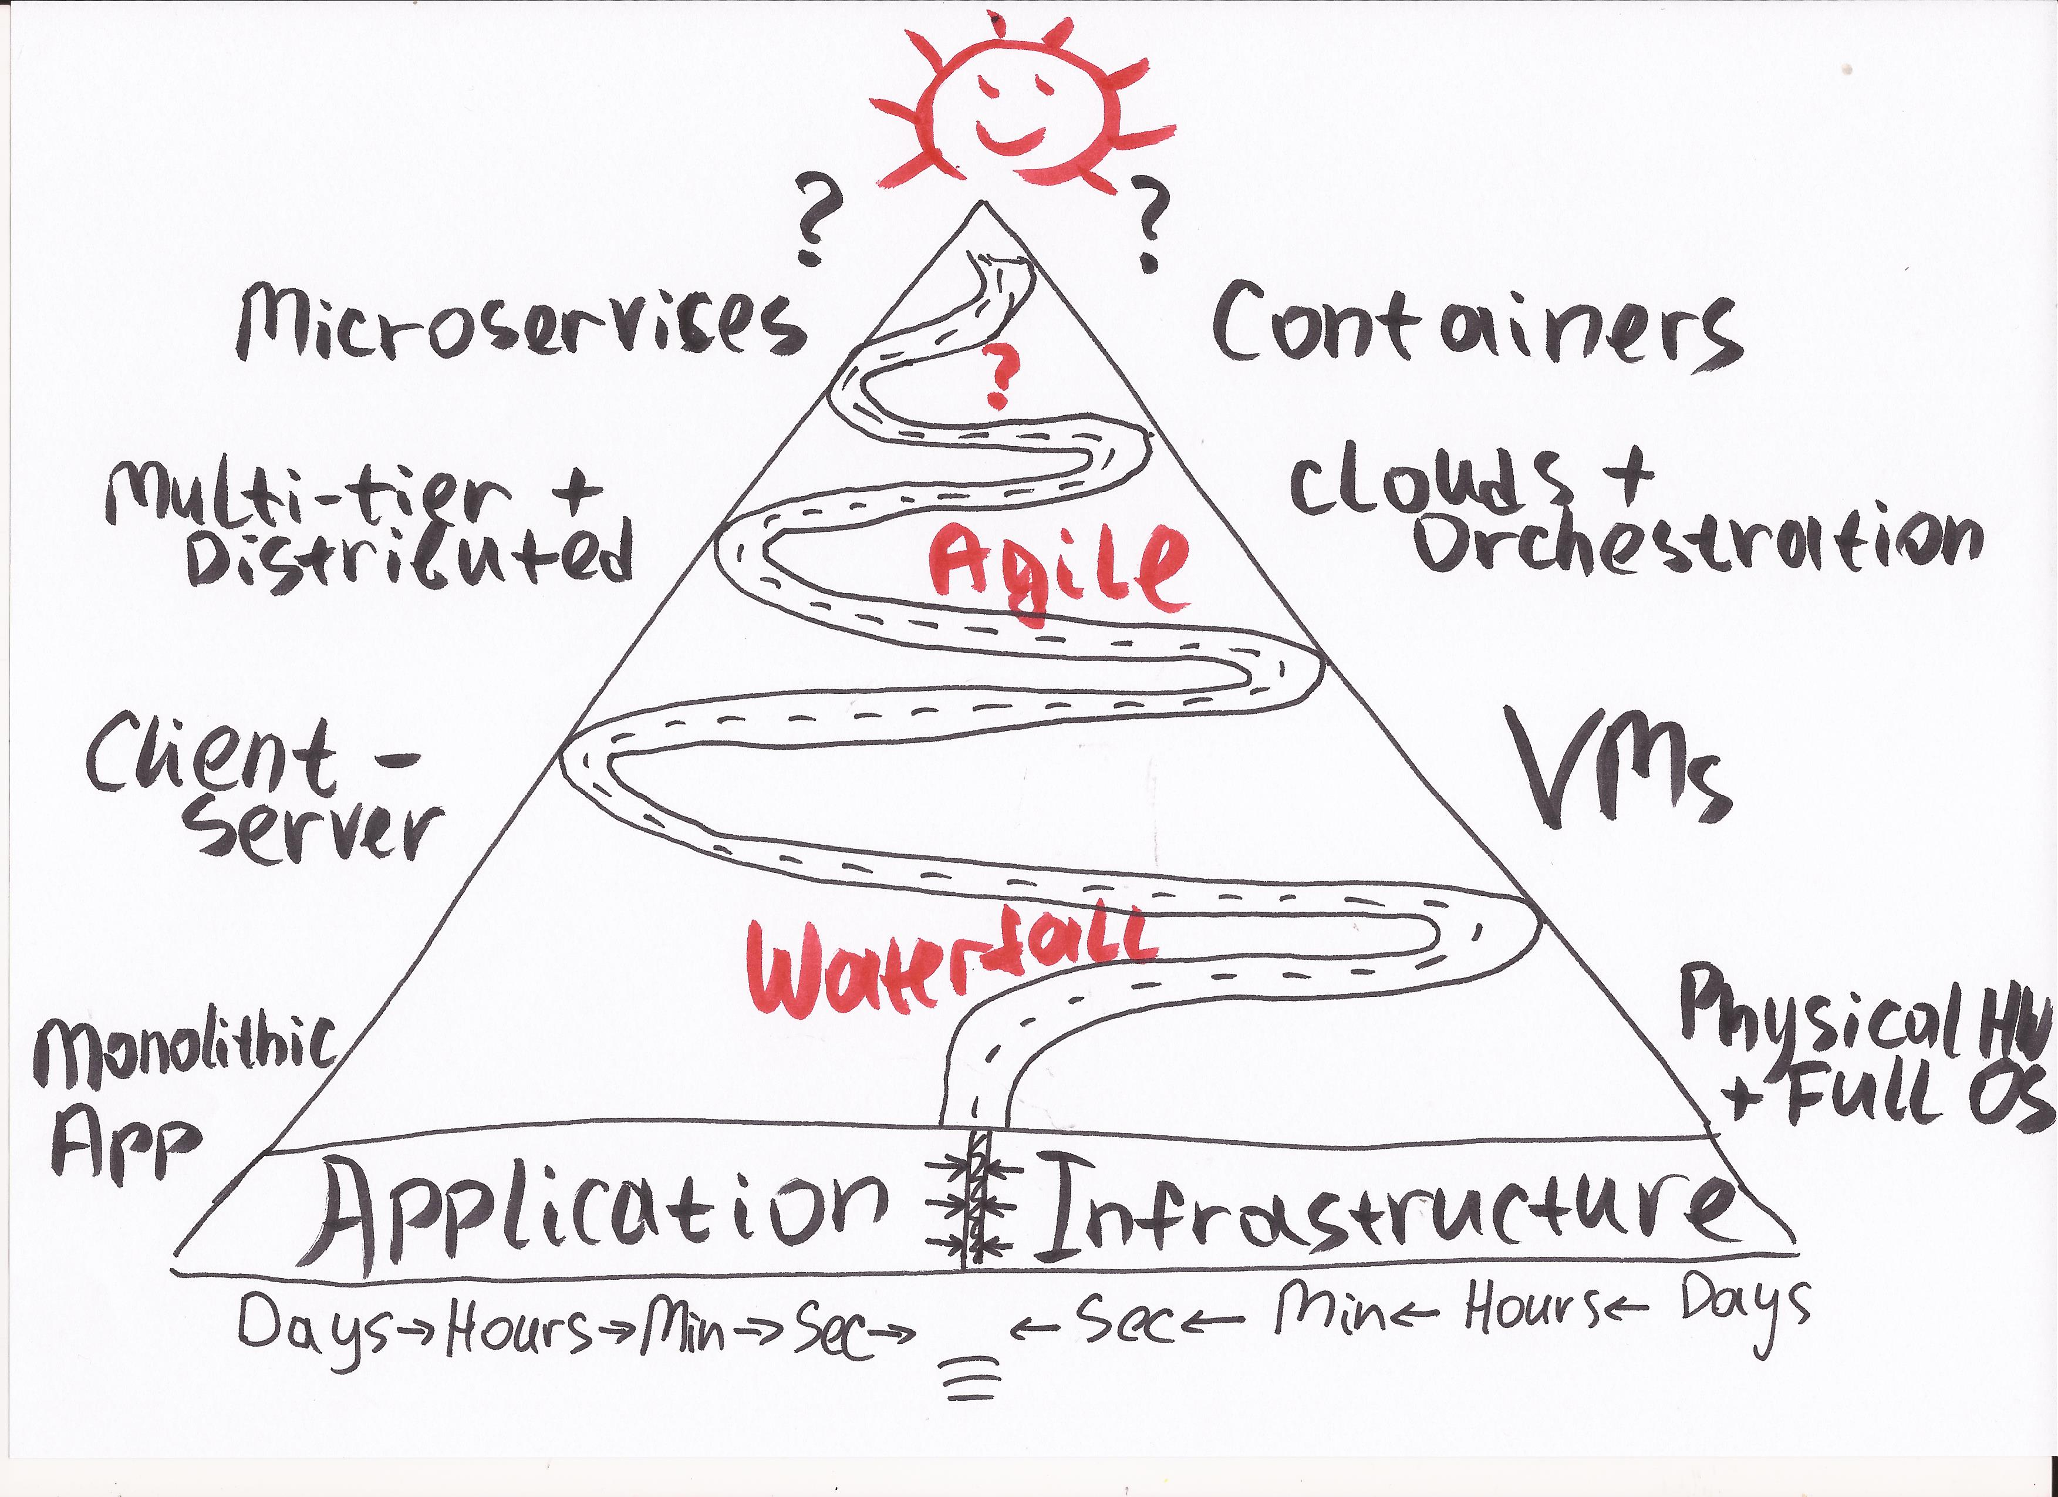
App/Infra Performance Parity
Notes:
Before we can answer the question about the future we need to address the two forces trying to be in balance.
Application and Infrastructure performance. We see on-going optimisation of App followed by optimisation of Infra and then App again …
When one of them is out of balance we see a new technological break through
In the last year containers took this out of balance in favour on Infra enabling introduction of microservices

Slide 48
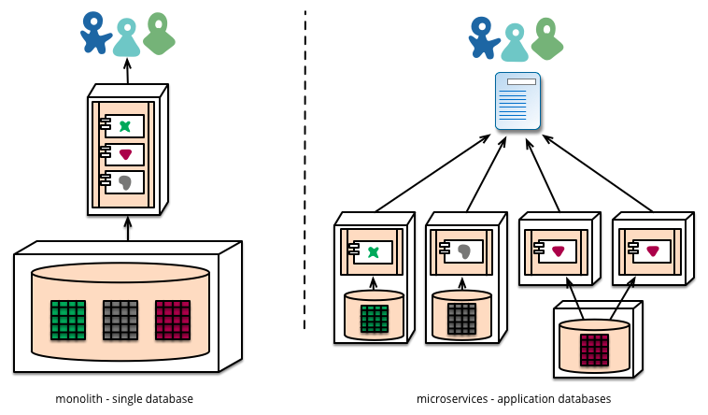
Microservices
Notes:
So, what are microservices? microservice architectural style is an approach to developing a single application as a suite of small services, each running in its own process and communicating with lightweight mechanisms.
Examples are a service to provide address of a person or recommendation for a movie based on personal preferences on the Netflix site.
But how this will affect our organisations?

Slide 49
Conway’s Law
organizations which design systems ... are constrained to produce designs which are copies of the communication structures of these organizations
Notes:
The Conway’s law suggests that we can only build software systems resembling our organisational structure.
Or in other words – if you have four team for building a compiler you will get a 4 steps compiler.
This is the reason for the creation of monolithic applications by a hierarchical development organisation and also the reason behind the DevOps movement.
Organisational division between Dev and Ops is now forcing to take a side and either merge them to build a single app or clearly divide them to define a clear API

Slide 50
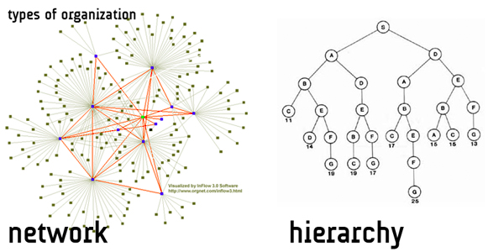
Network-centric organization
Notes:
And if we want to do microservices well, we need to continue moving towards the network-centric organisational structures.
Such networks already widely used in our world if you take all the companies into account. The next step for the companies doing microservices would be to introduce this within the organisation.
Or maybe the other way around, you first change your organisation and as a result you get the microservices architecture.

Slide 51
antitude

Slide 52
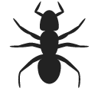
Antitude
www.antitude.io

Slide 53
Antitude
• Self Healing
• Automatic Scaling
• Efficient Hardware Utilisation

Slide 54
DockerCon Amsterdam in November
Docker Meetups

Slide 55
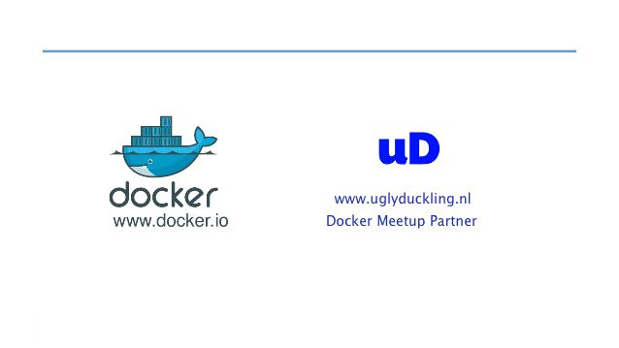
DockerCon Amsterdam Conference in November
Docker Meetup every month
Notes:
We are doing Docker Clinic at ….
You can come over and explain your situation to us and we will suggest the way Docker can help, or not, your organization
You can ask Jamie or more details.

